Slide 1
CSN104: Analog and Digital Electronics
YEAR 1
LECTURER: Dr. Alfred UWITONZE
CONTACTS: Phone number: 0788549588
E-mail: alfruwitonze@gmail.com
Academic Year 2022-2023

Slide 2
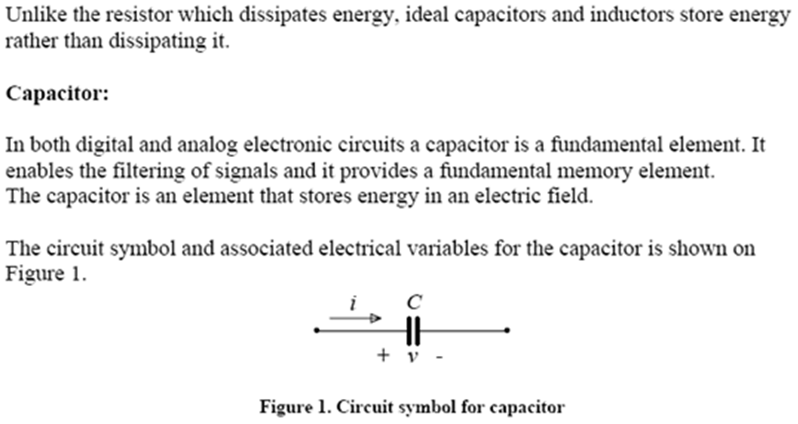
CAPACITORS

Slide 3
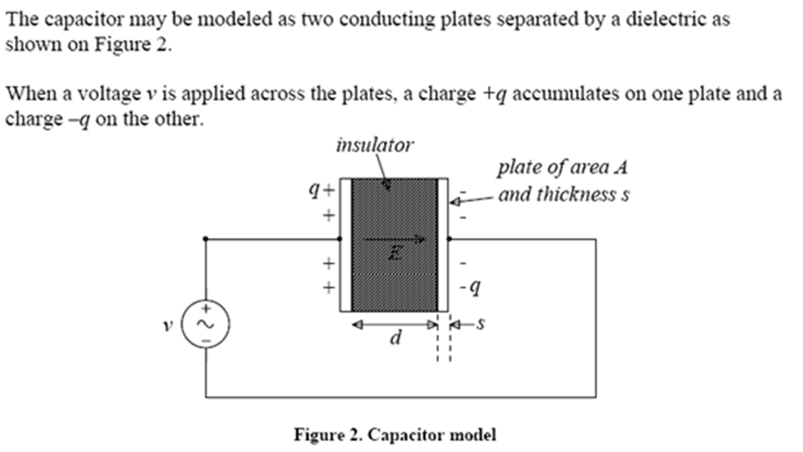
CAPACITORS

Slide 4
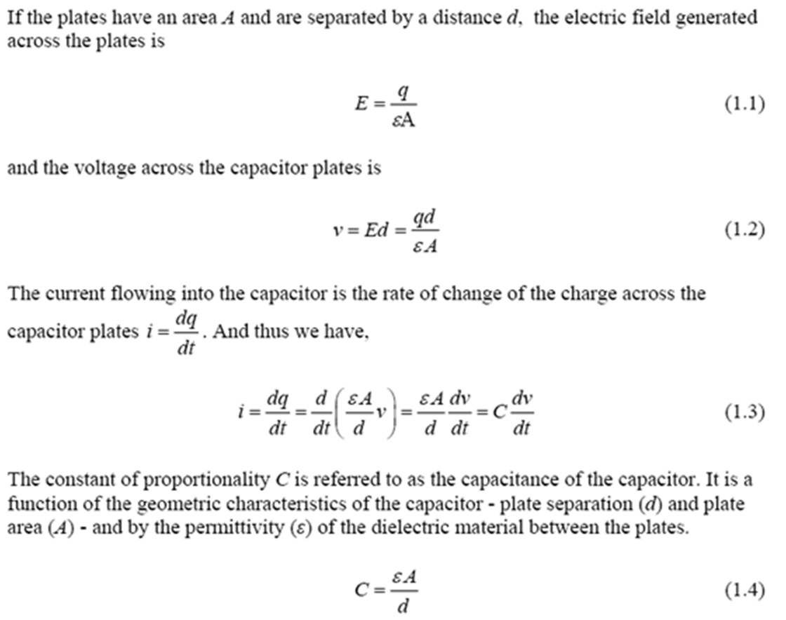
CAPACITORS

Slide 5
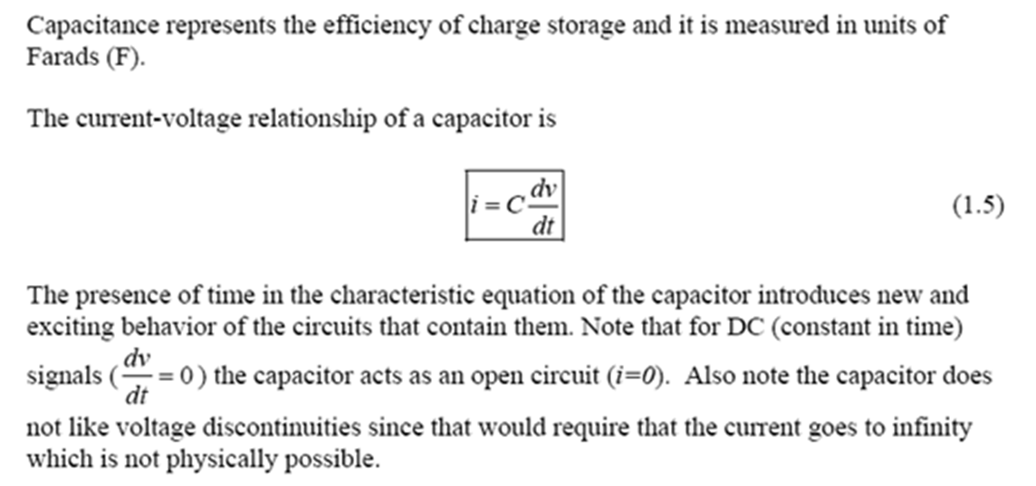
CAPACITORS

Slide 6
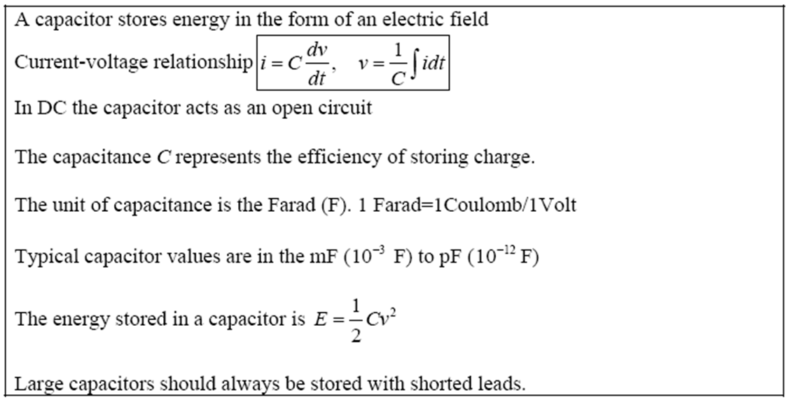
CAPACITORS

Slide 7
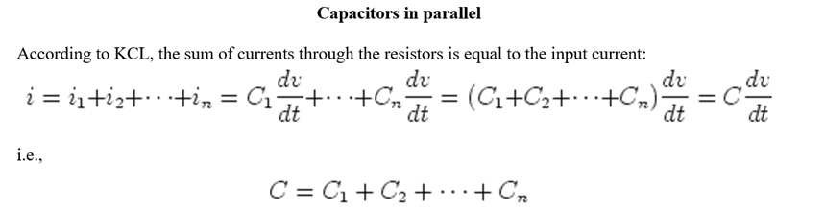
CAPACITORS

Slide 8
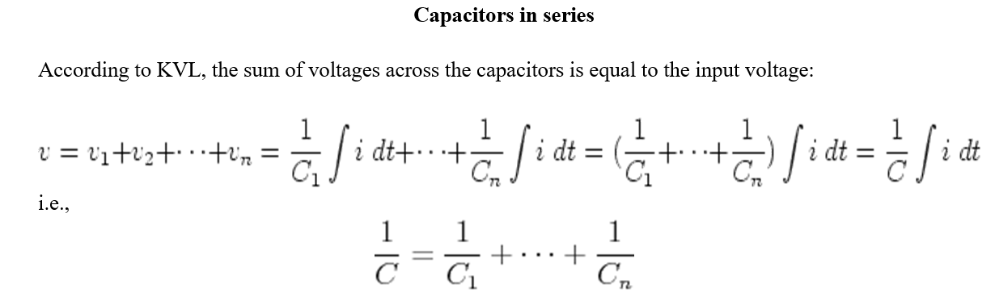
CAPACITORS

Slide 9
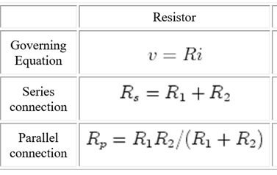
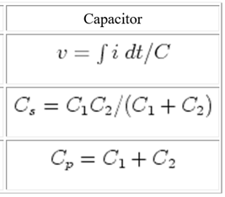
CAPACITORS

Slide 10
CAPACITORS
Example:
Consider two plates, separated by d=1.5 cm where the electric field between them is 100 (V/m), and the charge on the plates is 30.0 mC. What is the capacitance of the plates?

Slide 11
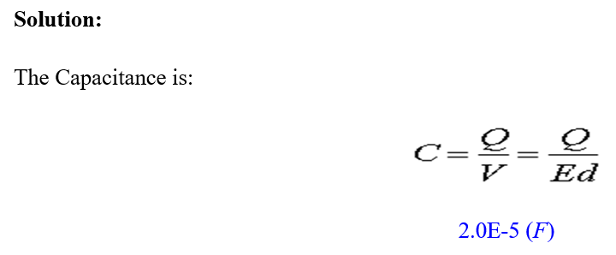
CAPACITORS

Slide 12
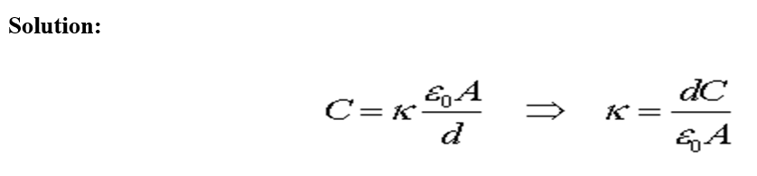
CAPACITORS
Example #2:
Consider a capacitor made of two 0.05 m² plates separated by 0.5 mm. If the capacitance is 3.0 nF, what is the relative permeability, k, of the material between the plates?

Slide 13
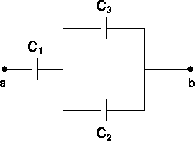
CAPACITORS
Example #3:
What is the capacitance of the following segment of a circuit?
DATA: C1=C2=C3=3.0 mF

Slide 14
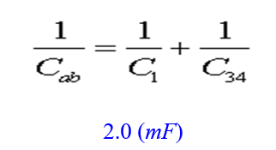
CAPACITORS
Solution:
The capacitance of the two in parallel is C₃₄=C₃+C₄. The capacitance of the entire circuit is:
If a voltage V_{ab} = 6.0 V is applied, what is the charge on each capacitor?

Slide 15
CAPACITORS
Solution:
Use V_{i}=Q_{i}/C_{i}. Check when you are done that the voltages add up to 6.0 V.
V₁ = 4.0 V, V₂ = V₃ = 2.0 V

Slide 16
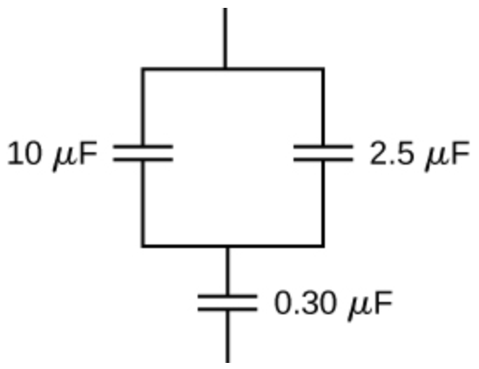
CAPACITORS
Example #4:
Find the total capacitance of this combination of series and parallel capacitors shown below:

Slide 17
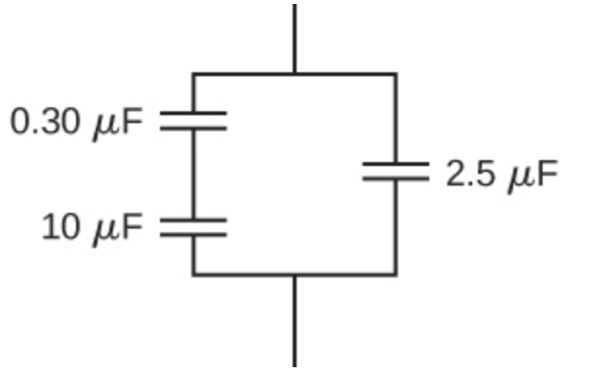
CAPACITORS
Example #5:
Find the equivalent capacitance of the combination of series and parallel capacitors shown below:

Slide 18
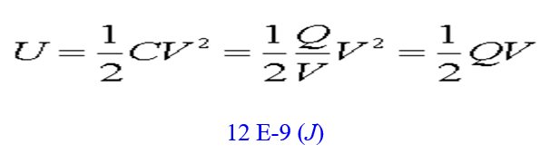
CAPACITORS
Example #4
A capacitor has a charge of 3.0 nC when the voltage across the capacitor is 12 V. What is the energy stored in the capacitor?
Solution: The Energy is:

Slide 19
END!!!

